Slide 1


Materská ľútosť v českom kontexte: tematická analýza hĺbkových rozhovorov
Lenka Štěpánková
Kvalitativní metody ve výzkumu X.
11.12.2025

Slide 2
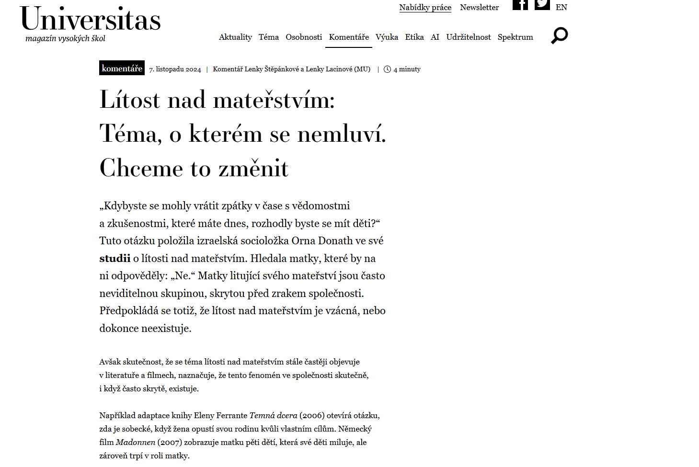
Orna Donath (2015): Regretting motherhood
Keby ste sa mohli vrátiť späť v čase s vedomosťami a skúsenosťami, ktoré máte teraz, mali by ste deti?
Ako sa prejavuje ľútosť vo vašom každodennom živote?
Kedy ste po prvýkrát pocítili túto ľútosť?
Hovoríte o pocitoch ľútosti v materstve s niekým? Ako často? S kým?
Existujú nejaké výhody alebo nevýhody mať deti?
Rozmýšľali ste niekedy nad tým, že by si odišli (od rodiny, od dieťaťa)?
Ako sa váš život zmenil po tom, čo ste mala dieťa?

Slide 3
Method
Participants were 10 Czech mothers, who responded to an article in the Universitas magazine published in December 2024.
Two participants were 30-34 years old,
seven were 35-40 years old
and one was 41-45 years old.
Two of them have two children (between 0-3 and 4-6 years of age; between 4-6 and 7-9 years of age),
the rest have one child (seven have children between 0-3 years of age and one between 4-6 years of age).
Braun´s and Clarke´s (2006) thematic analysis approach
Our analysis considers themes through a data set, is semantic and takes a realist perspective.
The semi-structured interview consisted of questions that were inspired by Orna Donath´s structure of interviews, based on her book and personal communication.

Slide 4
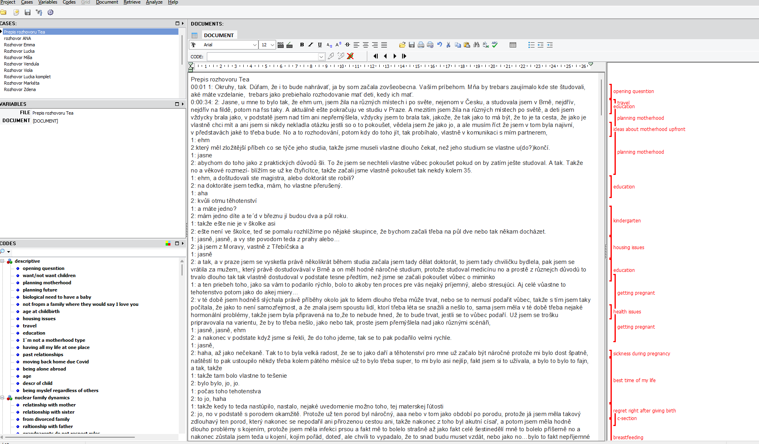
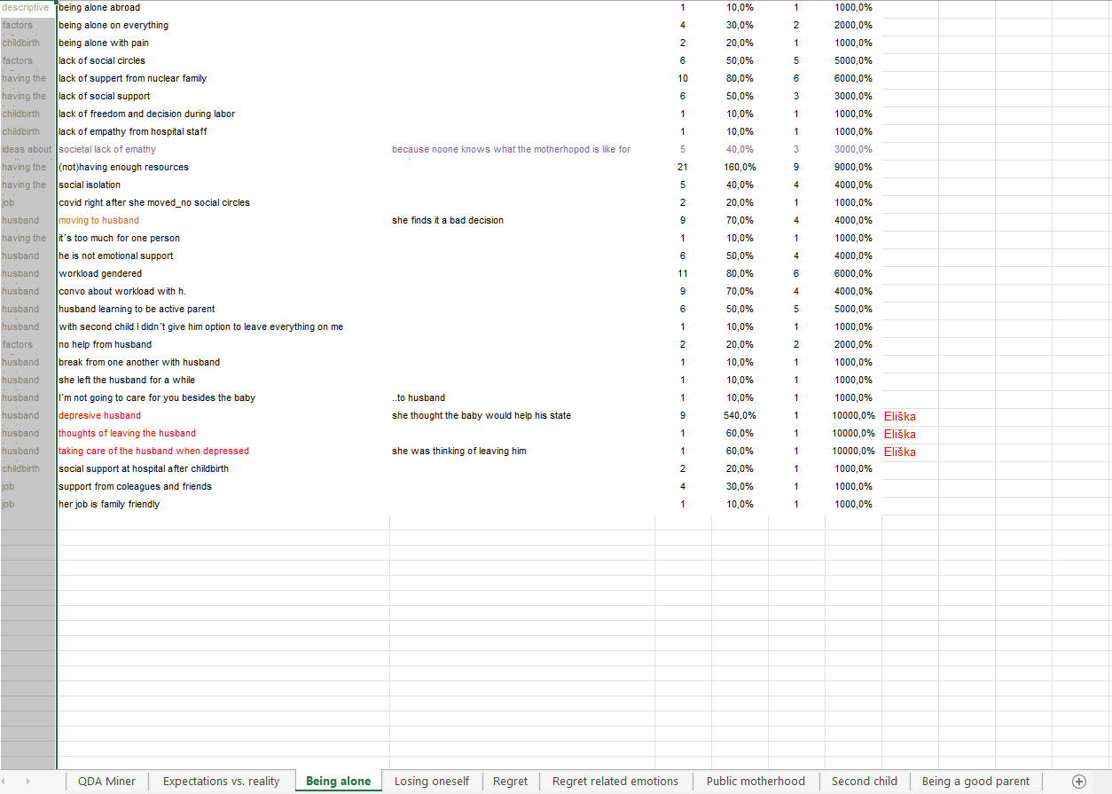
QDA Miner Light (free verzia) + excel

Slide 5
Analysis
8 final themes
There were more than 400 codes after the initial coding.
there were eight themes defined from around 300+ codes; (around 90 were marked as miscellaneous and were not worked with further.
the miscellaneous codes were related to descriptives of participant´s life; health issues; husband related topic; description of pregnancy and childbirth; job related remarks; participant's nuclear family dynamics.
Motherhood: expectations vs. reality
Being alone
Losing oneself
Regret (manifestation and temporal character)
Regret related emotions in motherhood
Motherhood surveillance
Second child
Trying to be a good parent

Slide 6
Motherhood: expectations vs. reality
(Viola, one child, 0-3 y.): “But then something completely irrational happened — something just kind of snapped in my head, and I guess that typical thing started, like that maternal instinct kicking in. I don’t even know where it came from, from somewhere deep inside, and then I just felt like I had to have children. There wasn’t any rational reason for it at all, but…"
Tea (one child, 0-3 years of age): “...but I have to say I was quite naïve about it — in my ideas of what it would be like. I also had these rosy expectations, like those images of children peacefully sleeping, with plenty of time for everything, and helpful grandmas always around (laughs). Well, I sobered up very, very quickly — realizing it wasn’t like that at all, that it was damn hard."
Ana (two children): ”Honestly, I didn’t. I jumped into it headfirst and I wasn’t prepared at all. I had always thought that motherhood would fulfill me completely. I was looking forward to it — to being on maternity leave, pushing the pram... and then my first daughter absolutely hated the pram, completely, so I was like, what is this?” …” You can study a lot about it [motherhood and childcare], but nothing really prepares you for what it actually does to you."

Slide 7
Being alone
One interesting group of codes were describing a specific situation, where a participant moved to her husband´s city, where she did not have any social circles and then had a baby, which was a big contributing factor to negative maternal feelings.
Míša: "And so we decided that we’d move in together. There was a long consideration about whether here or there, and in the end I agreed to go here — which, looking back, I feel was the biggest mistake I’ve ever made. Because I’m not happy here, and it really affected my whole experience of motherhood and everything."
Tea said: "What really changed for me in motherhood was the huge sense of isolation — I had never been used to that, and I think it was one of the main reasons why I wasn’t feeling well afterwards, or even now. Being at home all day with a child, without the chance to just have a normal conversation with people… and also the fact that many people simply can’t relate or don’t understand it. There was this really strong feeling of being on my own, or somehow cut off from others."

Slide 8
Losing oneself
The theme of loss is represented in several areas of lives of our participants: losing oneself and one's identity, losing freedom and previous life, losing opportunities, changes and loss in relationship with a partner.
Ana: “So I’m just a mom, [...] like a cleaning lady here at home, but where am I? Where are my hobbies, where is my life? That’s gone. And now I’m 35 — will it ever come back? [...] Oh my God, what happened to me? What did that child do to me? But it’s not the child that did it. It’s something that’s there somewhere, and the child somehow brings it out, that is completely instinctive… well…” “So it’s unpleasant, and it feels to me like, it feels like since giving birth I haven’t been living, I’ve just been surviving. I still feel that strongly even now, that actually, like, I’m not living a full life.”
Lucka: “I think that’s just terrible. Since the little one was born, no one has asked me how I’m doing. [when] the little one slept, [my mom asked] how is she, but I’m your daughter — you could maybe try asking me how I am. Yeah, like in that moment, nobody really cares about you as a person.

Slide 9
Regret (manifestation and temporal character)
Markéta: “Now it’s harder for me [to say I wouldn´t have a baby again]. Since I know what he’s like and that he’s a nice child, I’d want to have him. But if I didn’t know that I’d have the same child, I’d probably say no. I wouldn’t be influenced by my emotional connection with this child, and if someone told me I wouldn’t have this child, I’d say no.”
Emma: “Maybe the first year, a year and a half, the first year when I had… I experienced these feelings all the time. That regret about motherhood. And then, over time, it started to fade a little.”
Lucka feels like the regret will never go away completely: “I don’t think so. That it’s, like, deeply rooted.” Eliška feels that regret is like a hook, that is somewhere inside and always will be there: “Look, it’s already there, it’s not something that, like… it comes like a hook, something there [inside]…”
Eliška thinks she may tell her daughter about her regret if she is brave enough to be this honest. But she would definitely talk about the demands of motherhood and that it is not for everyone. “"If I have the guts, then yeah. I think I might not tell her that I regretted having her (sorry, love), but that there are personalities who lose more than they gain. Who aren’t fulfilled by it, who just don’t get that ‘yay, I’m a mom’ feeling, you know."

Slide 10
Regret related emotions
Our participants talked about shame and guilt regarding their maternal regret. They feel like they should feel differently, or they shouldn´t feel what they feel.
Ana: "And I feel kind of ashamed, as if in front of them [her children] — like I'm somehow blaspheming, having such a beautiful family, beautiful daughters, that I conceived and gave birth without any problems… like, who do I think I am?„
Emma says she has never had to deal with anything more difficult than motherhood obligations, she added: "Never in my life have I been as low as I was in motherhood." "But I think what’s really important […] is to break that taboo, that… Yes, people say motherhood is beautiful, but I still haven’t really found that feeling in myself, like… I can’t say that I’m enjoying it.„
Viola: "I think a lot about the future and what’s ahead, and it doesn’t really matter whether it’s when they’re a baby or when they’re eight. I just see this long, endless road stretching out in front of me — one that can’t ever really end in some beautiful way, it just never ends. And that, I think, is what scares me the most, besides everything else."
Vendula even expresses certain envy towards people, who experience their parenthood as fulfilling: "When I see someone who genuinely feels like their child is the center of the universe, I think, wow — I wish I could feel that. That’s the very thing I wanted children for. And I just… don’t have it."

Slide 11
Motherhood surveillance
The term “maternal surveillance” refers to a societal tendency to perceive motherhood as some sort of public interest, where everyone is scrutinizing every maternal move and everyone can comment on everything and give unsolicited advice just because they have certain experience with parenthood themselves.
Our participants mention the overall generational clash about many topics in parenthood (breastfeeding, letting the baby cry when distressed, corporal punishment, respectful parenting, daycare appropriate age etc.) that the previous generations did differently and have strong opinions about, which they express, sometimes insensitively.
Lucka and Markéta both recall being told that if they didn’t have children, they would one day regret it. And Lucka criticizes the societal expectation from women to stay home on maternity leave for 3 years. She thinks it´s an outdated notion from the past.
Emma: “People think they somehow have the right to butt in — to tell you how to raise your own child. So it’s also teaching me that — it’s still a process, I’m still learning something every day — to stand my ground more, to protect that space, like: this is my child, I didn’t ask you for advice. You know? Like, if I wanted your advice, I’d ask. But you’re not going to tell me how to raise my own kid.”

Slide 12
Second child
Ana told us: “Not that I would completely desire a second one. I was like, I’ll extend my maternity leave, this and that. Before my maternity leave ends, I’ll go for it, and I was, like, yeah yeah, why not. [...]But… when I think about it, it was a relatively rational decision. More than that inner desire to have another child, the pregnancy, enjoy the baby again.”
Vendula: “At the same time, for me it was a kind of rational reason, that, hmm, I always wanted two children, and I was afraid, I was aware that if I didn’t have a second child because of the older child — so I’m already angry at her, for how she is, for how difficult it is — then I would actually be adding to that anger, like, because of you I don’t have the second child.”
Tea describes the situation like this: “And with the second child, it’s nonstop now. I’m dealing with it a lot, because I’m getting it from all sides — like, when will you have the second one, one child isn’t enough, you can’t do that to her that she’ll be an only child, and only children are terrible, and so on. It’s from all sides — my gynecologist says it, my friends, my family, and my husband would probably also like to have another child.”
Nevertheless, comments from family members and broader societal norms regarding only children lead some participants to experience internal conflict about their decision to have only one child, despite their personal lack of desire for another.

Slide 13
Trying to be a good parent
For all our participants, the strongest motivation in their motherhood is to create a great life for their children. They love them deeply even despite all the struggles and despite the ambivalence in the emotions revolving around the motherhood role.
As Ana puts it: “[...] sometimes it doesn’t even come up [the feelings of regret] — when we have those better days. When I see those little feet, it might sound like a cliché, but honestly, so many times I just look at them and think — these defenseless little beings, who really have only us right now. And we’re the ones creating their inner world. So I have to, I really have to pull myself together." and "When I look at them, I think, these are my daughters. These are my daughters. It might be completely bizarre, but I just look at them, and it keeps hitting me over and over. These are the children I carried, gave birth to, and now they’re sitting here, and they are my little girls. “
Emma talks about breaking the taboo: "It’s good to spread this, that a woman can feel like I felt that she doesn’t want the child [right after the childbirth], that it [motherhood] feels overwhelming, and that doesn’t mean she doesn’t love the child.„
Viola talks about her effort to never let her son feel like he was not wanted: "I think that maternal love for me is, I don’t know, I’d say about 70% stronger [than feelings of regret]. That the difficult moments, or even the thoughts about whether I should have done it or not [have a child], are strong at times, but in the overall context, they’re negligible, I hope."

